Slide 1
FSA COMPLIANCE & RISK MANAGEMENT
FSA MDS/Medicare Refresher Mini-Series
Part 4:
Medicare A Skilled Care Program 101- Review and Application
November 30, 2023
Julie Smith, BSN, RN, RAC-CT, QCP
Compliance Specialist

Slide 2
Session Agenda
        Medicare Overview
        Medicare A Requirements
        Medicare A Specifics-PDPM
        Beneficiary Notices
        Triple-check Process
Notes:
Take-away sheet lists items for each section
Will use many of references provided
Some for reference only – those not numbered. Will use mostly in order by number

Slide 3
Session Objectives
        Participants will gain a general understanding of the Medicare A Skilled Nursing program
        Participants will be able to examine current facility practices and identify opportunities for process improvement

Slide 4
Parts Of Medicare
        Different Parts of Medicare:
          A: Hospital, SNF, home health care, hospice care
          B: Doctor & other health care services, Outpatient care, Test/labs, DME, many preventative services
          C: Medicare Advantage Plan; Covers Part A, Part B
          D: Prescription Drug Benefit
          Medigap: Supplemental plans available for items not covered
Notes:
Medicare is Health Insurance, a government system for medical care.
For People age 65, under age 65 with certain disabilities and ESRD all ages
Medicare And You reference –for residents but gives detailed explanation of many parts and enrollment details

Slide 5

Medicare A

Slide 6
Medicare A SNF Preadmission Process
Verification of Benefits (Check for eligibility and days available HIPAA Eligibility Transaction System (HETS))
Ensure hospital admission vs. observation
ACO’s (verify program requirement)
Ensure skilled need
Checking for recent SNF Med A stays

Slide 7
Managed Care Pre-Admission
Before admission, determine plan requirements:
  Needed to be a participating provider
  Services covered and requirements
  Pre/re-authorizations
If authorizations are needed
  Who obtains? How often? How is it filed and reviewed?
Determine how billing is calculated: levels, PDPM, HIPPS, RUGS
  Be sure MDS staff is aware

Slide 8
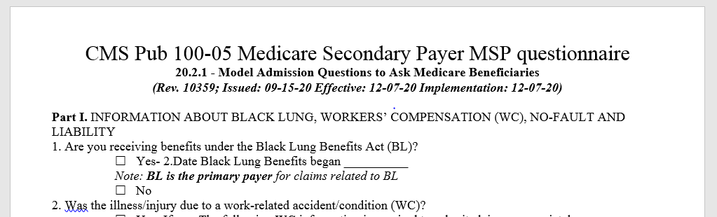
MSP- Medicare Secondary Payer
  MSP – determining if another payer may be primary vs. Medicare A
  Requirement prior to billing
  Advised completion on/prior to admission (each SNF admission)
Notes:
DVA-Dept Veterans Affairs
-Handout of sample questions

Slide 9
MSP- Medicare Secondary Payer
CMS MSP page:
https://www.cms.gov/Medicare/Coordination-of-Benefits-and-Recovery/Coordination-of-Benefits-and-Recovery-Overview/Medicare-Secondary-Payer/Medicare-Secondary-Payer- common secondary payer scenarios and COB page link and scenario
Benefits Coordination and Recovery Center (BCRC)
Mon-Fri 1-855-798-2627 (ask general MSP questions)
Notes:
DVA-Dept Veterans Affairs

Slide 10
Medicare A Specifics
Requirements

Slide 11
Medicare A Eligibility
Post-hospital extended care services – Up to 100 days
Unlimited number of benefit periods
Renewed after 60 days of non-skilled level of care
MLN SNF 3-day rule
CMS 100-02 Medicare Benefit Policy Manual Chapter 8

Slide 12
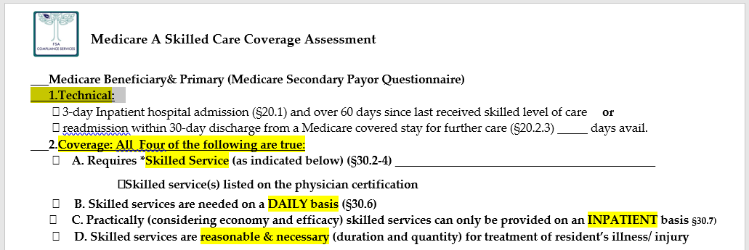
Medicare A Eligibility

Slide 13
Medicare A Technical Eligibility
Qualifying Hospitals (stays) – 3 midnights
Acute Hospitals
Critical Access Hospitals
VA Hospitals
Inpatient Rehab Hospitals
Long Term Acute Care Hospitals
Acute Psychiatric Hospitals
  While institutions that primarily provide psychiatric treatment cannot participate in the program as a SNF, a patient with only a psychiatric condition who is transferred from a psychiatric hospital is likely to received only non-covered care

Slide 14
Exemptions To 3-day Qualifying Stay
Special Shared Savings programs/ACOs approved by Medicare for exemption (Programs such as knee replacements)
  Verify special program requirements
Changing from a Medicare Advantage not requiring 3-day stay to traditional Medicare during the stay
  Condition code “58” on claim to indicate a patient was unenrolled from MA plan and 3-day stay not required to be met
  Medicare claims processing manual chap 6 section 90.1
Notes:
ACOs: Knee replacements

Slide 15
Medicare A Technical Eligibility
30-day transfer requirement:
Beneficiary must be admitted to SNF and receive the needed care within 30 calendar days after the date of discharge from a hospital or related SNF covered admission
Do not count day of discharge in determining 30 day period
Count day of hospital admission, not day of discharge (must be inpatient status, not observation status)
Day of hospital discharge must occur after effective date of Medicare
Confirm time of inpatient admission

Slide 16
Medicare A Technical Eligibility
Exception:
Delay in coverage due to medically predictable at time of hospital discharge that he/she will require covered care in a predetermined time period
Physician documentation needed of related, predictable time for SNF care in future
Example: Fracture with cast, may need therapy and skilled services once removed

Slide 17
Benefit Period
Ends 60 days after end of skilled care
If readmitted within 30 days continue episode related to hospital stay if there are days remaining (did not use all 100 days)
If admitted 31-60 new hospital stay is required to utilize remaining days
Benefit exhaust and No-pay claims
Notes:
Will discuss Exhaust and no-pay claims with billing

Slide 18
Medicare A Coverage Reason
Daily Skilled Service
“Post-hospital extended care services”- Up to 100 days
“Must require SNF care for a condition that was treated during the qualifying hospital stay, or for a condition that arose while in the SNF for treatment of a condition for which the beneficiary was previously treated in the hospital.”

Slide 19
Physician Skilled Certification
Services must be provided pursuant to a physician order
No particular form is required but all required elements must be documented
Physician Certification statement (initial)
  Need skilled care
  Daily basis
  Such services can only practically be provided
  Such services are for an ongoing condition for which the individual received inpatient care in a hospital
  A dated signature of the certifying physician or NPP
    F712 – NP or PA “employed by facility” may NOT sign

Slide 20
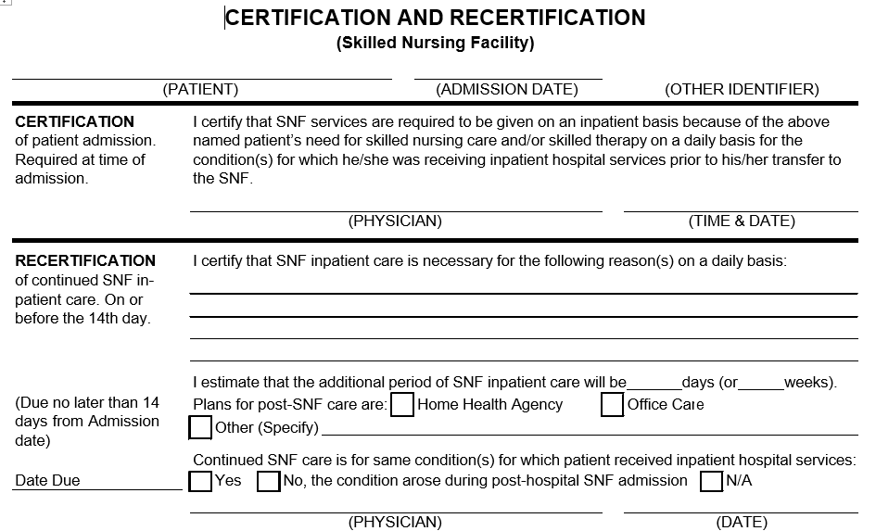
Physician Skilled Certification

Slide 21
Physician Skilled Certification
Re-certifications:
Reasons for the continued need for post hospital SNF care
Estimated time the individual will need to remain in the SNF
Plans for discharge (or TBD)
If the reason for continued need for services is a condition that arose after admission to the SNF (and while being treated for an ongoing condition for which the individual received inpatient care in a hospital) this must be indicated
A dated signature of the recertifying physician or NP

Slide 22
Physician Skilled Certification
Timing:
Initial: The certification must be obtained at the time of admission or as soon thereafter as is reasonable and practicable
1st re-cert: The first recertification is required no later than the 14th day of post hospital SNF care, (may be signed with initial if details for coverage are known)
Subsequent re-certifications are required at least every 30 days after the first recertification
Advise scan into EMR or paper chart

Slide 23
Delayed Certifications
“Note: SNFs are expected to obtain timely certification and recertification statements. However, delayed certifications and re-certifications will be honored where, for example, there has been an isolated oversight or lapse.
Delayed certifications and re-certifications must include an explanation for the delay and any medical or other evidence which the SNF considers relevant for purposes of explaining the delay. “

Slide 24
Presumption of Coverage
Administrative level of care presumption
  CMS Medicare benefit manual chapter 8 section 30.1
  Applies only with direct SNF admission from qualifying hospital
  Presumption is for macs reviewing claims
    Considered need for skilled care up until the ARD of the 5-day MDS (if completed by day 8)
    Level of care prior to MDS is presumed covered if case-mix is at a certain level, (because some services are evident)
    Ensure there is a care plan

Slide 25
Presumption of Coverage
Administrative level of care presumption
ONE of the following classifiers under the Patient Driven Payment Model (PDPM):
Nursing groups: Extensive Services, Special Care High, Special Care Low, and Clinically Complex nursing categories
PT and OT groups TA, TB, TC, TD, TE, TF, TG, TJ, TK, TN, TO
SLP groups SC, SE, SF, SH, SI, SJ, SK, SL
NTA component’s uppermost (12+) comorbidity group
Example: OCPA1- any of these would meet presumption

Slide 26
Medicare A Specifics –
PDPM Patient Driven Payment Model

Slide 27
PDPM Payment System
The Patient Driven Payment Model (PDPM) - goal to improve payments made under the SNF PPS in the following ways:
  Improves payment accuracy and appropriateness by focusing on the patient, rather than the volume of services provided
  Significantly reduces administrative burden on providers
  Improves SNF payments to currently underserved beneficiaries without increasing total Medicare payments
Notes:
From CMS training

Slide 28

MDS Frequency
Schedule for PPS MDS– only 2 types
Required (5day) and optional (IPA)
5 day PPS is only one required for the whole stay
BUT a Variable per diem adjustment schedule
  Tip: If no IPA, only one HIPPS code needed per claim. Note, if two lines are listed with same HIPPS code due to room changes some denial issues have occurred.

Slide 29
MDS Frequency
2nd type OPTIONAL
  IPA- interim payment assessment OPTIONAL
    MAY-MAY-MAY be completed at facility discretion for increased reimbursement due to resident changes
    Must consider all components and the timing to complete required interviews and assessments
    IPA payment changes with ARD of IPA
Notes:
Only time it was not optional was the transition period- used to transition RUGS to PDPM and special billing rules

Slide 30
Variable Payment Adjustment
PT/OT components, the case-mix adjusted per diem rate is multiplied against the variable per diem adjustment factor
After day 20, reduction of 2% of PT/OT component every 7 days.
Days in Stay | PT/OT Adjust. Factor | Days in Stay | PT/OT Adjust. Factor
1‐20 | 1.00 | 63-69 | 0.86
21-27 | 0.98 | 70-76 | 0.84
28-34 | 0.96 | 77-83 | 0.82
35-41 | 0.94 | 84-90 | 0.80
42-48 | 0.92 | 91-97 | 0.78
49-55 | 0.90 | 98-100 | 0.76
56-62 | 0.88

Slide 31
Variable Payment Adjustment
NTA components, the case-mix adjusted per diem rate is multiplied against the variable per diem adjustment factor
Adjustment factors are calculated automatically
CMS determined that these components adjustments will account increased care requirements over the stay
Daily Stay | NTA adjust. Factor
1-3 | 3.00
4-100 | 1.00

Slide 32
Interrupted Stay
Due to increased pay at beginning of stay the policy implemented to account for continued stay
If resident returns to the same SNF within the 3-day Interruption period, the stay continues
Variable payment adjustment schedule continues- does NOT start over
No new MDS is required- but MAY do IPA
LOA on bill for days out of facility
(Note that OBRA requirements for discharge/admission tracking MDS assessment are still required! Only PPS assessments for payment.)

Slide 33
Interrupted Stay
A interruption window- defined as the 3-day period:
  Interruption window begins on the first non-covered calendar day following a part a-covered stay and ends at 11:59 p.m. On the third consecutive non-covered day following a part a-covered stay
  Day 1- calendar day of discharge from SNF, or the day after the LCD if remains
  Includes the two immediately following calendar days (through 11:59 p.m.)

Slide 34
Health Insurance Prospective Payment System (HIPPS) Code
The HIPPS codes continue to be 5 characters
1st letter – PT/OT PDPM Group (A through P)
2nd letter – SLP PDPM Group (A through L)
3rd letter – Nursing PDPM Group (A through Y)
4th letter – NTA PDPM Group (A through F)
5th number– Assessment type (0 or 1)
or
Default rate ZZZZZ…because someone
was snoozing!!!

Slide 35
Default Code
ZZZZZ – missed the ARD grace period
  MDS ARD is after day 8
  If still on med A coverage a late MDS can be completed on day of discovery
  Bill the number of days late (after day 8) from beginning of stay
  Example: 5-day MDS ARD is day 11 THEN 1st 3 days of stay will be default
  reference: MDS RAI manual section 2.12

Slide 36
Default Code- ZZZZZ
If no MDS completed and resident no longer on covered stay –can’t be billed to Medicare
…..UNLESS
  Resident discharge, transfer or death on or before day 8
    If no MDS but stay less than eight days then default code is billed (bill HIPPS if MDS was completed)
  Reference: MDS RAI Manual Section 2.12

Slide 37
Key Tips for Completing a Few of the MDS Sections

Slide 38
PDPM-Functional Coding- GG
MDS Section GG
  Used for components: PT/OT uses 10 items; nursing- uses 7
  “Usual” functional abilities performance (day 1-3 post SNF admission and day 1-3 prior to planned discharge
  Review of process for collecting and analyzing data (IDT)
  Per RAI Manual must be documented in the medical record
Notes:
PAC-Post-Acute Care

Slide 39
Diagnosis Coding
All HIPPS components have some items that are impacted by diagnoses
Must be documented by physician in last 60 days AND must be active during MDS look-back

Slide 40
Diagnosis Coding
Important to work with providers to ensure there is documentation supporting Master Diagnosis list
Query providers as appropriate
Ensure process for frequent (at least quarterly) dx list reconciliation
Some EMR diagnosis list shows diagnosis codes that trigger one of the HIPPS components
  Recommend those (active) codes included on the claim since they impact reimbursement
Notes:
Access PCC – (RJ-SLP, LB-

Slide 41
Interview MDS Sections A, C, D, F, J and Q
Timely interviews (on or before ARD)
Must dash (-) if not, impact to SNF QRP & potentially reimbursement (SNF QRP Threshold Report)
Review facility process (paper vs. enter in MDS)
Section signatures
Section Z signatures (accuracy)

Slide 42
Malnutrition & Morbid Obesity Opportunity
Review/revisit process
MNA completion (all adm/readmits) ?
Query provider, provider acknowledgement & Care plan

Slide 43
So, How Do SNFS Get Paid For Bundled Med A Stay?
Answer:
  After the HIPPS code is determined by the MDS, it must be communicated to the MAC with certain information
  CMS requests an electronic claim form UB04 CMS-1450

Slide 44
Billing
Notes:
Get out blank claim and pull up the Claims code sheet

Slide 45
Billing Requirements
Beneficiary assignment of benefits and release of records should be on record – admission process
UB-04 (CMS 1450)
  CMS 100-04 claims processing manual chpt1 section 50.1.2
Monthly claims submitted sequentially
  Claim must be processed prior to next submission
Covered services listed on Med A claim
Claims for services furnished must be filed within one calendar year after the date of service (through date) on claim.
Consider MDS completion requirements in scheduling Triple-Check process/meeting

Slide 46
Billable Days
Date of Admission – Any services on or after this date are included in the PPS rate (unless excluded under consolidated billing); Day of Admission is a Medicare Utilization date
Generally the day of discharge, death or a day on which a patient begins a LOA, is not counted as a
utilization day

Slide 47
Midnight Rule
Midnight Rule (Billing Rule)
  A utilization day can not be charged if the resident is out of the building at midnight
  Review facility practice to ensure timely discharges are recorded and communicated

Slide 48
Assessing Continued Skilled Need - Utilization Review
Weekly Medicare meetings – assessing for continued skilled needs and discharge planning
Managing discharge expectations
Skilled Need determinations Chapter 8 Medicare Benefit Policy Manual

Slide 49
Beneficiary Notices

Slide 50
www.CMS.gov/bni
Some notices available in LARGE PRINT and Spanish
CMS Manual links (above)
CMS contact : BNImailbox@cms.hhs.gov

Slide 51
Two Types Required Notices
NOMNC-Notice of Medicare Non-Coverage
  Appeal: expedited review by QIO
SNF ABN’S-Advance Beneficiary Notice
  Appeal: via demand bill by MAC
    Notification of a Medicare service they won’t qualify for coverage; i.e.: ”Custodial care”
  Notify of beneficiary liability (cost)
    Med A-SNFABN [10055] -continued SNF stay after Med A stay (traditional Medicare)
    FYI - Med B-ABN [r-131]-continued non-covered therapy (traditional Medicare)

Slide 52
Two Types Required Notices
Notice | Med A | FYI - Med B
NOMNC CMS10123 (SNF, CORF, Hospice, HH) -QIO appeal | Traditional Medicare & Managed | Traditional Medicare but those in a SNF only
ABNs Traditional Medicare only -MAC appeal | SNF ABN –CMS10055 Traditional Medicare only | ABN R131- All levels of care with Traditional Med B BUT Only if going to receive non-covered Medicare service (less common)

Slide 53
QIO and MAC
1. Level One appeals: Two different appeals
QIO- Quality Improvement Organization (i.e. Livanta or Kepro) - appeal cut decision-NOMNC
MAC- Medicare Administrative Contractor
  In past known as FI, intermediary)- who pays your claims
  (i.e. Novitas-solutions for PA)- appeal the continued SNF stay being covered –SNF ABN for traditional Med A

Slide 54
Next Level Appeal
After QIO or MAC Appeals
2. Reconsideration by QIC- Qualified Independent Contractor (QIC)
3. OMHA (Office of Medicare Hearings and Appeals) adjudicator- Administrative Law Judge
4. Medicare Appeals Council
5. File Civil action in Federal District Court

Slide 55
If Resident Wants To Appeal:
Help Beneficiary know which process is more appropriate
Want to appeal end of the skilled stay or the continued stay
NOMNC will know decision by last covered day
SNF ABN - Demand bill process can take up to 90 days while accumulating bill
Can give both notices at once but if giving NOMNC first and going to higher level appeal be sure to give SNF ABN by Last Covered Day

Slide 56
If Demand Bill Requested
You do NOT continue skilled care (i.e. therapy ) just because in appeal process
Give another (facility) notice if resident wants therapy through the appeal process and you agree to provide non-covered therapy
  Therapy documentation should be accurate in reflecting supportive therapy at resident request
Still do end of PPS assessments for original cut date (last covered day); if in appeal recommend hold claim until final determination.

Slide 57
3rd-“Voluntary” Notices
Ftag 582 SNF Rule: Required written notice to resident of charges not covered by Medicare/Medicaid §483.10(g)(17)[Medicaid resident] /§483.10(g)(18)[Medicare residents]
If Not A Medicare service or Medicare would never pay, no SPECIFIC beneficiary notice is required
  “Technical Denial” examples:
  TV, hairdresser, ambulette
  No 3-day qualifying stay (except under waiver)
  Exhaust benefit -100 days Med A
  BUT YOUR OWN NOTICE IS STILL REQUIRED (F582)
May use the SNFABN or ABN as voluntary, but recommend using your own facility notice
  Options boxes not required
  Signature not required however, you do want evidence it was provided

Slide 58
Completing Notices
Review your facility (current) notices for these details in following slides
QIO denials for not completing correctly

Slide 59
NOMNC cms 10123
Community Name, address phone on top
Skilled Nursing Facility Services (Not only PT, OT, ST for Med A)
LCD should be consistent with end Medicare stay on MDS
Provide at least 2 days prior to LCD
  Do not extend Med A stay to give notice – occasional abrupt discharge if needed
Include all person notified, telephone number, date, time, date must call for timely review AND copy was mailed
Identification number is optional but advised, recommend MR number- Do not use Medicare Number
Send certified if unable to reach POA
Current version (approved 2011)

Slide 60
SNFABN CMS 10055
Provided when a resident is staying LTC after Med A LCD
SNF ABN Instructions have suggestions for reasons
Name, address, and phone number facility
Identification number is advised but optional, advise MR internal number- Do not use Medicare Number
May be used as optional/voluntary notice
Give with enough notice for resident to make decision

Slide 61
SNF ABN
Review Option Box Choices:
Option Box 1 – Demand bill – appeal (want Medicare to continue to pay for stay)
Option Box 2- No Demand bill, agree with liability
Option Box 3- Do not want Medicare billed and do not want to stay – typically = discharge

Slide 62
Beneficiary Notices and Hospice
Not required if resident electing Hospice from Med A
SNF may be required to provide notices to Hospice Residents IF in the rare instances of Dual eligible
GIVE your own facility notice for room and board charges

Slide 63
Beneficiary Notices and Hospice
Med A resident elects Hospice (one Med A option to another) a Specific Beneficiary notice is NOT required (Room and Board is not covered Medicare benefit with Hospice so SNFABN is NOT appropriate)
Rather provide your own facility notice to explain room and board charges

Slide 64
Remember….
  NOMNC and DENIAL/SNFABN provide notice of TWO DIFFERENT appeal processes
  NOMNC- expedited through QIO
  DENIAL/SNFABN- via demand bill through MAC
  AND provides notice of liability
  (Managed care: recommend using own notice with the required NOMNC to notify of continued charges)

Slide 65
References
CMS Manual reference:
  Medicare claims processing manual Chapter 30 - financial liability protections, 50.15.3.1 - special issues associated with the ABN for hospice providers
  C. When ABNs are not required for hospice services
    5. Room and Board Costs for Nursing Facility Residents
    Since room and board are not part of the hospice benefit, an ABN would not be required when the patient elects hospice and continues to pay out of pocket for long term care room and board
MLM Article 7903 re NOMNC
www.cms.gov/bni

Slide 66
Triple Check Process

Slide 67
History - Why
With increasingly high occurrence of fraud, waste, and abuse, OIG has planned to continue vigorous recovery efforts as reported in its annual work plan
To avoid becoming an audit target, organizations need to ensure that adequate steps are taken to properly incorporate practices within their compliance programs that promote accurate billing, high quality of care, and safety

Slide 68
History - Who
A Required Element of FSA Compliance
Recommended by CMS
  SNF PPS clarifications memo V1.1, March 2012 stated “providers should also have triple-check and other QA processes in place to ensure assessments are accurate prior to submission. Such monitoring and documentation is a part of the provider’s responsibility to provide necessary care and services.”

Slide 69
History - Who
CMS Final Rule March 2016 created an obligation for timely refund of overpayments
Duty to exercise reasonable diligence to avoid errors
Required pro-active Compliance Activities
  Staff training
  Triple check process for claims review prior to submission

Slide 70
Why So Important
Residents receive the benefits they are entitled to
Accurate billing for skilled services provided
Prevention of False Claims submission
Reduction of denied or adjusted claims/reimbursement
Correct data reported for the organization
Clinical and financial data should correlate
Support documentation is identified early

Slide 71
Triple Check Purpose
Assure billing accuracy PRIOR to claim submission
  Review all claims for Medicare A and B before they are submitted
  Serves as an audit of both clinical aspects and the billing items
Quality assurance initiative
  Helps identify trends in system and/or process issues
  Provides an opportunity to develop an action plan as a team
Meets the 60-day repayment/overpayment requirement
Meets OIG expectation for “reasonableness”
  Failure to audit will be considered unreasonable
Readiness for potential audits and reduction in paybacks (TPE, ADR, RAC, MAC, ZPIC)
Notes:
Failure to obtain an order or a certification
Identification of unnecessary services are considered overpayments

Slide 72
Reasons For Payment Denial
Technical denial
  Response to ADR did not contain documentation requested
  Documentation not received within requested timeframe
  Physician certification not signed or missing
  Illegible documentation
Clinical denial
  Documentation does not support medical necessity
  Documentation does not support daily skilled intervention by a licensed therapist (and/or nursing for Med A)
  Documentation in medical record must support continued progress

Slide 73
FSA Program Expectations
The biller sets the date based on ability to complete the claims
Meetings should begin on time and be consistent with date and time and location
Attendance is expected to be in person, not remote
Meeting participants should come prepared
  Pre-meeting work completed
  Bring specific items
Documentation of the process and findings should be maintained through the triple check log
Prioritization needs senior leadership support
Reduce or eliminate social conversations
Frequency is dependent upon volume
  High volume generally biweekly
  Low volume generally monthly

Slide 74
Who Should Participate
Triple Check participants
Biller
Therapy Manager
Social Service
Nursing
Medical Records
MDS Coordinator
NHA is encouraged to take part in the process as well to be aware of non-compliance
Compliance representative should attend sporadically to validate process

Slide 75
What is Included in Process
UB-04 claim
MDS assessment
ICD-10 diagnosis list
Medical record documentation
  Nursing
  Therapy
  Interdisciplinary team
Medicare certifications/re-certifications
Medicare Secondary Payer forms
Census for claim period
NOMNC & ABN’s

Slide 76
Business/Billing Office
Review accuracy for:
  Bill type
  Hospitalization dates
  Admission and occurrence dates
  Correct payer(s)
  Resident data: name, social security and Medicare number
  Organization information
  Correct physician(s) and NPI

Slide 77
Nursing
Review accuracy and supportive documentation for:
  MDS assessments
  Physician SNF certifications/re-certifications
  Primary ICD-10 as well as all other active diagnoses
  Clear support for each case mix group
  Mechanically altered diets & swallow impairments
  Over use of IPA
  Billing for services not provided or rendered
  Supporting medical record documentation

Slide 78
Therapy
Therapy items for the Triple Check include:
  Validation of physician orders for skilled care received
  Treatment/service logs
  Signed Plans of care and updated plans of care
  Physician orders and clarification orders
  Therapy start and end dates
  Therapy justification as determined by resident clinical needs
  >25% group/concurrent

Slide 79
Effective & Efficient Triple Check
Other items that can be evaluated during the process:
  Medicare Secondary Payer form completion
  Notice of NOMNC and/or ABN timeliness
  Census data
  Reconciliation of external vendor billing including laboratory, radiology, pharmacy and therapy

Slide 80
Items To Review
  Starting with the claim
  Beneficiaries name, date of birth, Medicare and social security numbers
  Bill type (FL 04)
  Admission date (FL 12)
  Occurrence span: qualifying hospital stay dates (FL 35-36)
  Correct payer (FL 50)
  From and through dates of claim: billing period (FL 06)
  Revenue codes: SNF PPS or therapy discipline codes (FL 42)

Slide 81
Items To Review
Admitting, primary and secondary diagnoses (FL 67 then a-q)
    Correlate to diagnosis list in EMR, section I of MDS assessment, primary diagnosis in I0020B to be first listed, MD admission history and physical, MD progress notes, MD orders and therapy plans of care
HIPPS code (FL 45)
    Correlate to HIPPS code from section Z of MDS assessment, final validation report and assessment indicator from MDS
Covered days per MDS assessment or service units (FL 46)
    From the days covered by each MDS assessment on claim
    If IPA the HIPPS code starts with ARD of IPA
Notes:
While claim diagnoses are not REQUIRED to match MDS, CMS says they EXPECT that it will.
Recommend:
List I0020B primary diagnosis first listed-principle on claim
Then list diagnosis supporting the HIPPS code and major comorbidities
If any space remains, can list therapy treatment codes. For Med A therapy is paid by primary and functional scores. If SLP include the codes triggering mapping and SLP component.
Therapy treatment codes support medical necessity for therapy and are included on POC , may not make it to the claims.

Slide 82
Items To Review
Looking at the MDS
  ICD-10 codes checked against the PDPM ICD-10 mappings provided by CMS
  Swallowing and dietary needs
  Interviews - evidence of timely completion
  Assessment reference date (ARD) within allowable time frame
  Skilled services coded on MDS assessments
  Correlate section O rehabilitation therapy days and minutes with the rehabilitation treatment/service logs
Notes:
If done by EHR, verify using the EHR location such as diagnosis list

Slide 83
Items To Review
Checking therapy
  Each treating discipline should have a POC and/or UPOC
  POC/UPOC should be signed timely by MD and/or NPP
  Each treating discipline should have MD orders for evaluation and treatment
  Review number of minutes documented on MDS with treatment/service logs (avoid rounding)
  Ancillary visits accurate on claim (Medicare A)

Slide 84
Remember
Any discrepancies on the claim need to be reconciled prior to submitting the claim
Claims are held until all data needed to support a claim are complete and accessible in the resident’s record
Documentation of the Triple Check process should be maintained and reported to Compliance
  Findings/accuracy or error rate
  Participants
Potential to significantly impact cash flow
  Late billing
  Paybacks

Slide 85
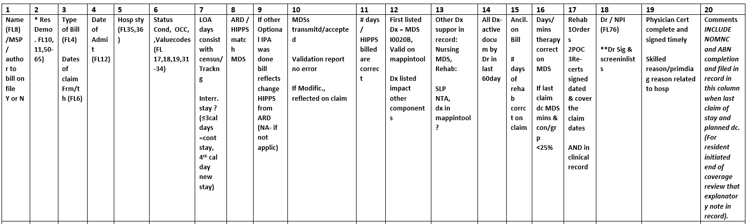
Sample Log – Med A

Slide 86
Please Email Questions
Q & A’s Will Be Shared With All Attendees
Julie Smith, BSN, RN, RAC-CT, QCP
Compliance Specialist
T: 267-822-6789
E: smith@fsainfo.org

Slide 87

Medicare Manuals & References
Manuals:
https://www.cms.gov/Regulations-and-Guidance/Guidance/Manuals/Internet-Only-Manuals-IOMs
CMS NTP-National Training Program
  Learning network-previous CMS education referenced in documents
MAC websites
www.cms.gov
Notes:
In accordance with the Proverb “Give a man a fish you feed him for a day, teach a man to fish and you feed him for a lifetime.” – Proverb [various origins cited] want to provide you with resources you can check as questions arise. Of course FSA is always available to assist as well.

Slide 88
Additional References/Resources
Resident Assessment Instrument Manual: https://www.cms.gov/files/document/finalmds-30-rai-manual-v11811october2023.pdf
State Operations Manual, Appendix P-PP, Survey Guidance to Surveyors: https://www.cms.gov/Medicare/provider-enrollment-and-certification/guidanceforlawsandregulations/downloads/appendix-pp-state-operations-manual.pdf
MDS 1.18.11 Form, etc.: https://www.cms.gov/Medicare/quality/nursing-home-improvement/resident-assessment-instrument-manual

