Slide 1
Regulatory Update
Paula G. Sanders
Principal and Chair
Health Care Practice Group
Post & Schell, P.C.
FSA Compliance Collaborative
11th Annual Conference
September 25, 2024

Slide 2
Objectives
Discuss recent federal and state regulatory developments affecting long-term care and post-acute providers
Learn how to prepare your staff for increased enforcement initiatives and Phase Three implementation issues
Develop compliance strategies for regulatory risk mitigation

Slide 3
Abbreviations
CMP: Civil money penalty
CMS: Centers for Medicare and Medicaid Services
DOJ: Department of Justice
DPNA: denial of payment for new admissions (mandatory)
DDPNA: Discretionary denial of payment for new admissions
IDR: Informal dispute resolution
IIDR: Independent informal dispute resolution
IJ: Immediate jeopardy
MC: Medicare
NATCEP: Nurse aide training and competency and evaluation program
NHA: Nursing Home Administrator
OCR: Office of Civil Rights
OSHA: Occupational Safety and Health Administration
POC: Plan of correction
SNF: Skilled nursing facility
SOM: State Operations Manual,
Appendix PP
SQC: Substandard Quality of Care

Slide 4

Disclosures and Revalidations

Slide 5
CMS’ Transparency Initiatives
New regulations governing disclosure requirements and increased screening scrutiny
Prior to January 1, 2023, SNFs were designated as “low risk” for initial enrollment, revalidations, restructuring and changes of ownership/operators (CHOWs/CHOPs)
Now SNFs are considered “moderate risk” to program integrity for revalidations and “high risk” to program integrity related to initial enrollments, restructuring and CHOWs/CHOPs

Slide 6
Screening: Revalidations – Moderate Risk
Meet all three criteria under the “low risk designation”
  Meet applicable state/federal requirements for provider type
  License verifications across state lines for providers that have Medicare billing privileges
  Database checks are done pre/post enrollment to make sure provider meets enrollment requirements for provider type
  AND
An onsite visit by a National Site Visit Contractor to verify accuracy of enrollment information and to determine compliance with Medicare enrollment before revalidation can occur

Slide 7
High Risk Screening
Must meet criteria for low and moderate risk, AND
All individuals with 5% or greater direct/indirect ownership interest must
  Submit fingerprints for national background checks and
  Undergo fingerprint-based criminal history record check at FBI Integrated Automated Fingerprint Identification System
Practical implications: significant delays in getting Medicare approvals, payment delays

Slide 8
New CMS Disclosure Requirements
Expanded disclosure requirements include broader categories of “managing employees” and “additional disclosable parties” (ADPs) not required prior to November 2023
  Includes individuals who have direct hands-on responsibilities and managers, supervisors and/or advisors regarding finances or operations
  Includes Medical Directors (hospices also required to report)
  And others (CMS to issue new sub-regulatory guidance and new 855a)

Slide 9
CMS “Additional Disclosable Party”
Exercises operational, financial, or managerial control over the facility or a part thereof
  Provides policies or procedures for any of the SNF’s operations
  Provides financial or management services to the facility
Leases or subleases real property to the facility or
  Owns a whole or part interest equal to or exceeding 5 percent of the total value of the facility; or
Provides --
  Management or administrative services
  Management or clinical consulting services
  Accounting or financial services to the facility

Slide 10
Other Medicare Reporting Deadlines
Change of ownership or control, including changes in authorized official(s) or delegated official(s) within 30 days
All other changes (e.g., managing employees) within 90 days (42 C.F.R. § 424.516(e))
Other disclosable parties when submitting revalidations, reenrollments or recertifications or within 35 days of a written request for such information (42 C.F.R. 420.206)

Slide 11
855A - Section 6 Managing Employees
All managing employees of the provider must be reported in Section 6 of the 855A
This includes but is not limited to, a general manager, business manager, administrator, director, medical director, or other individual who exercises operational or managerial control over, or who directly or indirectly conducts, the day-to-day operations of the provider, either under contract or through some other arrangement, regardless of whether the individual is a W-2 employee of the provider
Must report medical director NOW per CMS MLN February 8, 2024
CMS-855A form (09/23) Section 6 page 34

Slide 12
F844 - §483.70(k) Disclosure of Ownership
SNF must comply with the disclosure requirements of §§420.206 and 455.104
Must provide written notice to State Agency at the time of change, if a change occurs in—
  Persons with an ownership or control interest
  Officers, directors, agents, or managing employees
  Corporation, association, or other company responsible for the management of the facility
  Administrator or director of nursing

Slide 13

The Risk - Medicaid Revalidation SNAFUs
Paula,
Sorry that was not clear, but I really don’t have a good answer. We submitted the revalidations in July. Then in December they sent an email which was missed, and by the time we were aware it was missed it expired. We do not know what was the original issue with the submission, as they would not tell us. I resubmitted the SNF revalidation document, the same as it was originally submitted because I didn’t know what the issue was and I wanted to get it submitted. So ultimately, we don’t know what the issue is, just that there was no option for an expedited review to keep us active.

Slide 14

Potential Pitfall

Slide 15
Blocked Access
We had issues with the filing as it was blocked and under a person who had left probably 8 years ago. I was able to get that reverted back to me, last week and my goal is to resubmit the filing tomorrow night. The biggest concern is delay in payment and how long it could take, as the first time it was over 5 months till they responded. If you need other documents please let me know, and will do my best to respond quickly, but I am booked most of the day with meetings.

Slide 16
On-Site Revalidation Visits
Conducted by CMS contractors who show up unannounced with badge/ID and letter but you cannot take pictures of either
Two types of visits:
  Observational – photos, minimal contact
  Detailed—speak with staff and collect info to confirm compliance with Medicare standards
Typically provide limited explanation of what they are doing

Slide 17
Who Are the Contractors?
East: Palmetto GBA and its subcontractors
West: Deloitte Consulting, LLP and its subcontractors
Overland Solutions, Inc., an affiliate of EXL
Information Discovery Services
Compliance Review, Inc.
National Creditors Connection, Inc.
Nationwide Management Services, Inc.
CSI Companies, Inc.
Arthur Lawrence Management, LLC
Computer Evidence Specialists, LLC

Slide 18

Staffing Challenges

Slide 19
Phasing Of Federal Rule
Aug. 8, 2024 – Facilities must meet the new facility assessment requirements
May 11, 2026 – Facilities must meet the 3.48 HPRD total nurse staffing requirement and the 24/7 RN requirement
May 10, 2027 – Facilities must meet the 0.55 RN and 2.45 NA HPRD requirement

Slide 20
Federal Staffing Exception
Good faith efforts to hire and retain
  Post notice at facility
  Provide notice of status and current compliance with HRPD
  Copy to Ombudsman
Not eligible if:
  Failed to submit their data to the Payroll Based Journal System (PBJ)
  Are a Special Focus Facility (SFF)
  Have widespread, or a pattern of, insufficient staffing that resulted in actual harm to a resident

Slide 21
Litigation Challenges CMS Staffing Rule
Two cases filed in federal court in Texas, now consolidated
  AHCA filed by AHCA and joined by Leading Age
  State of Texas also filed
On 9/6/2024 CMS filed 75,000 page administrative record
On 9/9/2024 joint motion for briefing schedule filed
Potential resolution may be reached as early as January

Slide 22

Facility Assessments

Slide 23
Facility Assessments - F838; 42 CFR 483.71
Staffing: ensure sufficient number of staff with appropriate competencies and skill sets necessary to care for resident population identified through resident assessments and care plans
  Must use evidence-based data-driven methods to address care needs
  Competency-based approach to determine the knowledge and skills required among staff
Address specific staffing needs for each resident unit and adjust as necessary based on changes to resident population

Slide 24
F838 Competency-Based Approach
Determine knowledge and skill sets required among staff (incl. both employees and contractors) and volunteers, to meet resident needs (physical, functional, nursing, mental, and psychosocial well-being) and meet current professional standards of practice
Include any ethnic, cultural, or religious factors to meet resident needs, such as activities, food preferences, nutrition services, and any other aspect of care identified
Consider a review of individual staff assignments and systems for coordination and continuity of care for residents within and across these staff assignments

Slide 25
Facility Assessment Considerations
Should address specific staffing needs for each shift, including weekends and nights
    Address how care needs may be different by shift
Develop and maintain a plan to maximize recruitment and retention of direct care staff
Show contingency planning for events that have the potential to affect resident care but do not require activation of emergency plan

Slide 26
F838 Mandatory Participants
Member of the governing body
Medical Director
Administrator
Director of Nursing
Direct care staff, including but not limited to RNs, LPNs and Nurse Aides
Representatives of the direct care staff, if applicable
Also: solicit and consider input” from residents and representatives/ family members

Slide 27
Practice Tips - Facility Assessments
Pennsylvania requires quarterly facility assessments
Avoid formulaic assessments
What types of residents can facility treat?
  SUD – discrimination rules?
  Violent residents?
  Elopement risks?
  Language barriers?
Address behavioral health needs
  Staff
  Consultants
  1:1’s

Slide 28

Survey Enforcement

Slide 29
Federal Scope/Severity Grid Distribution
Scope
Severity | Isolated/Few people affected | Pattern/Some people affected | Widespread/Many people affected
Level 1 No actual harm, with potential for minimal harm | A — least serious 0% | B 1.44% | C 1.28%
Level 2 No actual harm, with a potential for more than minimal harm | D 61.95% | E 23.29% | F 6.57%
Level 3 Actual harm that is not immediate jeopardy | G 3.22% | H 0.15% | I 0.01%
Level 4 Immediate jeopardy to resident health or safety | J 1.36% | K 0.52% | L — most serious 0.21%
https://projects.propublica.org/nursing-homes/

Slide 30
Federal CMP Inflation: 2016 to 2023
Scope/Severity | Per Day | Per Instance
IJ: J/K/L Category 3 with IJ | $3,050 --$10,000 2023 $7,884 -- $25,847 | 2016 $1,050 -- $10,000 2023 $2,586 -- $25,847
Category 3 without IJ | 2016 $3,050 -- $10,000 2023 $7,884 -- $25,847 | 2016 $1,050 -- $10,000 2023 $2,586 -- $25,847
Category 2: F/G/H/I | 2016 $50 -- $3,000 2023 $129 -- $7,754 | 2016 $1,000-- $10,000 2023 $2,586 -- $25,847
Grounds to waive disapproval of nurse aide training program increases to $12,924
https://www.cms.gov/files/document/ltc-hha-clia-specific-cmp-adjustments-2023.pdf (eff. 10/6/2023)

Slide 31

Substandard Quality of Care
Required notification to all physicians in the facility (via letter to the medical director)
Automatic referral of NHA to state licensing board (and sometimes DON)
Loss of Nurse Aide Training and Competency Program (NATCEP)

Slide 32
Denial Of Payment For New Admission
Don’t expect a separate notice from CMS
“If you do not correct the cited deficiencies AND achieve substantial compliance with the requirements of 42 CFR Part 483 … within 90 days CMS and State must deny payments for new admissions. Additionally, they will recommend that your provider agreement be terminated, six months from the date of the partial-extended survey.”

Slide 33
DPNAs
New Admissions
  Does not apply to residents who leave temporarily for any reason (SOM §7506(B)-(D); 42 C.F.R. 488.401)
  Residents admitted before effective date of denial of payment and taking temporary leave are NOT new admissions upon return if placed in MC bed
  To determine whether resident was admitted prior to the DPNA, status of resident, NOT primary payor, controls
  Discharge from SNF breaks the cycle

Slide 34
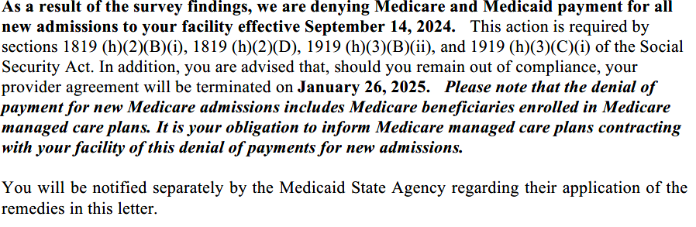
Discretionary DPNA

Slide 35
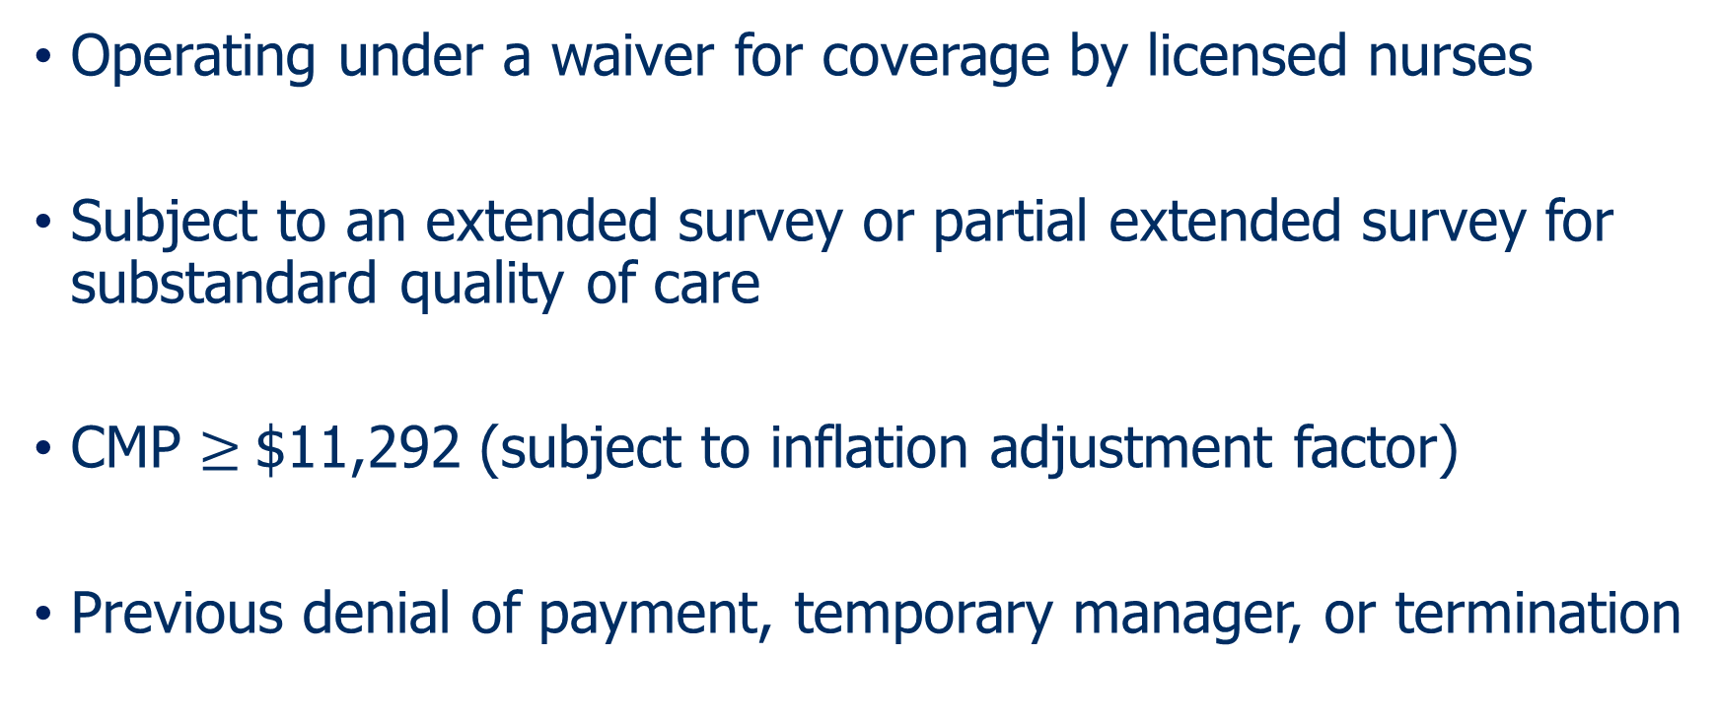
Loss Of NATCEP Program
Operating under a waiver for coverage by licensed nurses
Subject to an extended survey or partial extended survey for substandard quality of care
CMP $≥$$11,292 (subject to inflation adjustment factor)
Previous denial of payment, temporary manager, or termination

Slide 36
Requesting Waiver Of Loss Of NATCEP
State may grant waiver and allow NATCEP program to be offered in (but not by) SNF if the State —
  Determines that there is no other such program offered within a reasonable distance of the SNF
  Assures, through an oversight effort, that an adequate environment exists for operating the program in the SNF
  Provides notice of such determination and assurances to the State Long-Term Care Ombudsman
Does not require CMS approval

Slide 37
Other NATCEP Waiver Options
If CMP ≥ $12,924 and deficiency is not related to Quality of Care for residents – meaning direct hands-on care and treatment that a health care professional or direct care staff furnished to a resident
State may recommend waiver, but CMS Regional Office makes the determination

Slide 38
“Required” Plan Of Correction (POC) Elements
What corrective action(s) will be accomplished for residents affected by the deficient practice?
How will you identify other residents having the potential to be affected by the same deficient practice and corrective actions?
What measures will be put in place or system changes will you make to ensure that the deficient practice does not recur?
How will the corrective action be monitored to ensure the deficient practice will not recur, i.e., what quality assurance programs will be established?
Dates when the corrective action will be completed

Slide 39
Consider POC Disclaimer Language
Preparation and submission of this plan of correction is required by state and federal law. This plan of correction does not constitute an admission for purposes of general liability, professional malpractice or any other court proceeding.

Slide 40
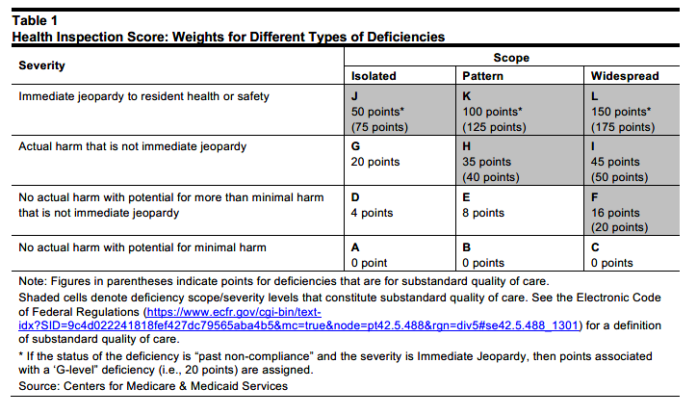
Points Grid

Slide 41
Aim For Past Noncompliance
Significant reduction in points
Turns an IJ into a G

Slide 42
What Is Past Noncompliance?
Past noncompliance generally means a facility has sufficient evidence to show that it corrected a deficient practice before the survey
Past noncompliance is best supported by an effective and well documented internal POC

Slide 43
How Does CMS Define Past Noncompliance?
Deficiency identified during a current survey with a S/S at "G" or above, or Substandard Quality of Care (SQC) findings at a S/S at "F" that meets all of the following three criteria:
  Not in compliance with the specific regulatory requirement(s) at the time the situation occurred
  Noncompliance occurred after the exit date of the last standard (recertification) survey and before the survey (standard, complaint, or revisit) currently being conducted
  There is sufficient evidence to support that the facility corrected the noncompliance and is in substantial compliance at the time of the current survey for the specific regulatory requirement(s)

Slide 44

What Is Sufficient Evidence To Prove Past Noncompliance?
Resident?
Other residents?
Prevention?
Monitoring?

Slide 45
Immediate Jeopardies?
Elopements
Suicidal ideation
Hoarding pills
Water temperatures
Call bells

Slide 46

Respond Quickly To Serious Events
The key to meeting past noncompliance is to treat all serious incidents as one would respond to an immediate jeopardy situation
  Assessing the resident(s) involved in the incident
  Removing the perpetrator pending investigation
  Reporting to all applicable agencies and law enforcement (if applicable)
  Assessing and protecting other residents

Slide 47
Respond Quickly To Serious Events
  As appropriate, educating staff and volunteers (if applicable), ensuring they will not work with residents until they have been educated
  Implementing corrective measures
  Monitoring and auditing
  Reviewing the incident at the Quality Assurance and Process Improvement (QAPI) Committee to assess root causes and needed system improvements
  Documenting all of the above so that when the surveyors investigate the self-reported incident, they will have the “sufficient evidence” to support citation as past noncompliance

Slide 48
New CMS Enforcement Regulations
Effective 60 days after published-October 5, 2024 but not operationalized until March 3, 2025
Allows imposition of multiple per instance (PI) CMPs for the same type of noncompliance
  For each instance of noncompliance, a per day (PD) CMP of $3,050 to $10,000 (as adjusted), a PI CMP of $1,000 to $10,000 (as adjusted), or both, in addition to the other remedies may be imposed
Allows PI and PD CMPs on the same survey
  Expands authority to impose both a PI CMP and a PD CMP, not to exceed the statutory and regulatory maximum amount on any given day, even when combined
89 FR 64048 (Aug. 6, 2024), https://www.govinfo.gov/content/pkg/FR-2024-08-06/pdf/2024-16907.pdf

Slide 49
“Instance of Noncompliance”
Defined as a separate factual and temporal occurrence when a facility fails to meet a participation requirement
  Each instance of noncompliance is sufficient to constitute a deficiency
  A deficiency may be comprised of multiple instances of noncompliance
If multiple instances of noncompliance occurred prior to the survey, could impose multiple PI CMPs, as well as a PD CMP
If survey contains multiple instances of noncompliance, any combination of PI or PD CMP for each instance of noncompliance within the same survey may be imposed
For each instance of noncompliance, a PD CMP, PI CMP, “or both” may be imposed, regardless of whether the deficiencies constitute immediate jeopardy

Slide 50
New Enforcement
Both PD and PI CMPs can be imposed on the same survey and included on the penalty notice to facilities
Removed the phrase, “for that particular deficiency,” and replace with, “per instance,” which will allow for more than one PI CMP to be imposed on the same type of noncompliance or “F tag” citation
  The date and instance of noncompliance is not a singular event but rather can be multiple date(s) of the instance(s) of noncompliance
Timing of enforcement
  Allows imposition of CMPs for noncompliance that was identified since the last three standard surveys

Slide 51
Three Year Look Back
Changed “since the last standard survey” to “since the last three standard surveys”
Intended to catch surveys where CMPs were missed but . . .
  “the current regulatory scheme still requires that CMS investigate any received complaints, without any temporal limitation on the specific alleged deficiencies complained of, and thus the possibility of investigations into allegations during the proposed look-back period is possible”

Slide 52
Options To Challenge
First level IDR
  Must be filed 10 days after receiving 2567 (same day POC is due)
  CAN BE REVERSED BY CMS
Second level IIDR
  Must be filed 10 days after receiving CMS Sanction Letter
  Does not affect ability to receive 35% CMP reduction
    35% CMP reduction is only lost if you file an appeal

Slide 53
Administrative Appeals And Then To Court
CMS Sanctions
  Appeal within 60 days and lose 35% CMP reduction
  Must file electronically to Departmental Appeals Board (DAB)
  Cases go first to an administrative law judge (ALJ)
  Next level of appeal is to the DAB

Slide 54

Other Agencies

Slide 55
OSHA Severe Injury Reports
Employers required to report all severe work-related injuries within 24 hours of the incident
  Amputation, in-patient hospitalization, or loss of an eye
Data from 1/1/2015 to 12/31/2023 now online and searchable
Assisted living communities reported 149 severe injuries
  140 hospitalized and 13 amputations
  Most due to falls and tripping
CCRCs reported 103 series injuries
  95 hospitalized and 8 amputations
  Top reason falling due to tripping over an object or slipping
https://www.osha.gov/severeinjury#xd_co_f=NmZkYTc1MjktMzVjMi00YjE2LWI2YzYtOGQxYTM3N2QyYTVj~
Statistics summarized by McKnights Senior Living Sept.11, 2024

Slide 56
New Federal Discrimination Rule
Implements Section 1557 of Affordable Care Act (ACA)
Prohibits discrimination based on race, color national origin, age, disability and sex
  Pregnancy
  Sexual orientation
  Gender identity, stereotypes or characteristics
Requires appointment of coordinator, new policies and notices

Slide 57
Section 1557 Policies
Nondiscrimination based on sex
  Cannot discriminate or impose restrictions on care based on a patient’s gender identity or sex assigned at birth
Nondiscrimination based on marital, parental or family status
  Can’t discriminate based on children
Nondiscrimination based on association
  I.e., son or daughter with Substance Abuse Disorder (SAD)

Slide 58
Timeframe For Section 1557 Compliance
November 2, 2024 – Must post notice to beneficiaries, enrollees and to the public
July 5, 2025 – Notice of availability of language assistance
May 1, 2025 – Train staff on policies

Slide 59
Section 1557 Enforcement
OCR enforces, but can refer to DOJ
Can bring administrative proceedings to revoke ability to receive federal funds
Allows private cause of action

Slide 60
Practical Considerations
Prepare Your Employees
  Many instances of “off-the-cuff” statements
  Know and prepare for interviews
    Was there a report?
    Who was involved?
    Did s/he give a statement?

Slide 61

The Light At The End Of The Tunnel May Be A Train

Slide 62
Questions?
Paula G. Sanders
Principal & Chair
Health Care Practice Group
Post & Schell, P.C.
17 North Second Street
12th Floor
Harrisburg, PA 17101-1601
717-612-6027
psanders@postschell.com

