Slide 1

Navigating an Escaped Convict:
Emergency Preparedness and Excellence in Execution

Slide 2
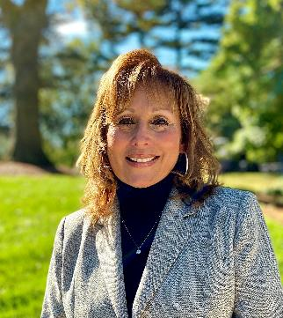
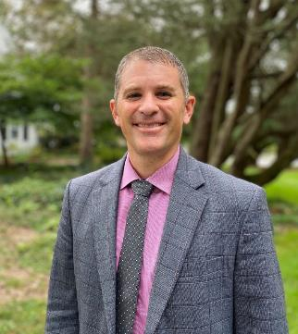
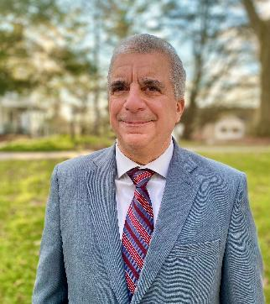
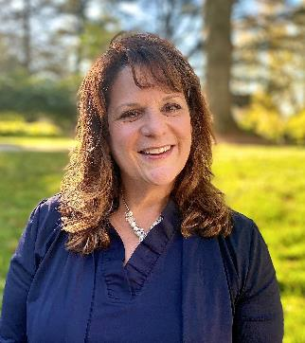
Your Hosts Today
Lisa Marsilio
Chief Executive Officer
Seth Beaver
VP, Community Services
Roy Manno
Director, Facilities
Michele Berardi
Sr. Dir, PR and Communications

Slide 3
Lisa Marsilio
Chief Executive Officer

Slide 4
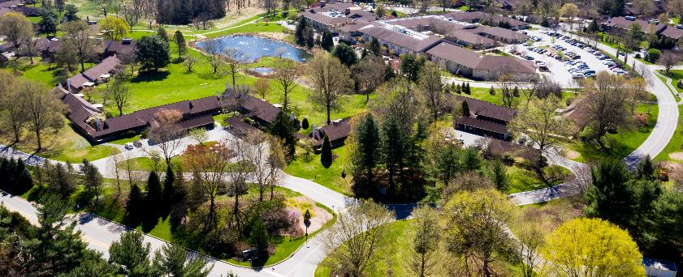
Our Community
Quaker Founded
2 - Life Plan Communities (Kendal at Longwood and Crosslands)
2 - 50+ Communities (Coniston and Cartmel)
Over 900 residents and over 600 staff members
500 acres, adjacent to Longwood Gardens, Kennett Square
11 miles of hiking trails, meadows, manicured gardens, ponds, outdoor amenities, indoor community spaces
Sprawling campus with cottages and apartment buildings

Slide 5


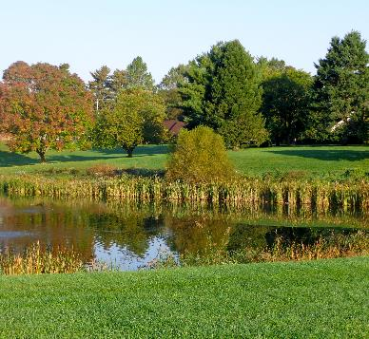
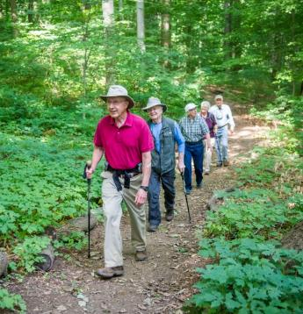
500 acres!

Slide 6
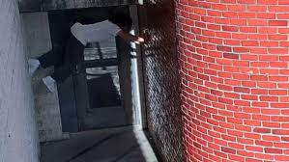
The Crab Walk Seen Around The World

Slide 7

About The Escaped Prisoner
Convicted murderer – a dangerous criminal
Waiting to be extradited to a state prison - - this low security local prison was temporary
Excellent survival skills – as he escaped prison before in Brazil

Slide 8
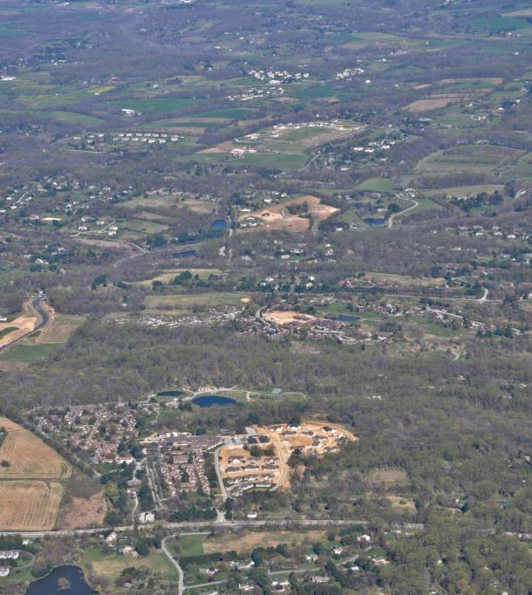
Coniston
Prison
Cartmel
Crosslands
Longwood Gardens
Kendal at Longwood

Slide 9

It Started Labor Day Weekend
Teams of staff were on vacation, out of state, out of the country
Emergencies (of any kind) never happen at an opportune time
Quickly mobilized leaders from our ‘playbook’ from COVID
Provide strategic direction to ensure the safety of residents and staff

Slide 10
What We Will Cover Today
First notice was Thursday, August 31 and from there, Roy Manno will describe our timeline over 10 days
Communication is key in any crisis and Michele will discuss all methods of notifications
Seth will describe our debrief, what worked well, the relationships that were essential with law enforcement
We will end with our personal perspectives

Slide 11
Roy Manno
Facilities Director

Slide 12
Timeline (Days 1 – 2)
Thursday, 8/31
12:23 PM – Singlewire Lockdown sent
Notified all residents via emergency notification system that our communities were now in a lockdown status and residents should remain indoors as much as possible. Access to community areas would be via badge access and additional Facilities staff would be patrolling our communities.
Emails and other notifications continued
Friday, 9/1
By afternoon, with extensive police presence in the area we remained on lockdown but returned to normal dining schedules and activities.

Slide 13
Coniston
Prison
Cartmel
Official and Confirmed Prisoner Sighting (9/2/23)
Crosslands
Longwood Gardens
Kendal at Longwood

Slide 14
Timeline (Days 3 – 6)
Saturday, 9/2
6:45 AM – Facilities receives unconfirmed report that escapee is in the local area.
7:02 AM – Escaped prisoner confirmed in Waterglen community
7:30 AM – CEO directs opening of the Kendal-Crosslands Command Center, Notifications Issued
9:00 AM –Command Center Opens, Communities Remain on Lockdown
Saturday, 9/2 through Monday 9/5
Command Center staffing plan in place for 24 hour a day coverage
Communications protocols set for residents and staff
Safety rounds established for all communities
Police and Federal agencies briefings are ongoing
Sightings are reported and investigated
Bus services to/from meals established and dinner moved up
Refreshments for staff and first responders supplied to Command Center

Slide 15
Coniston
Prison
Cartmel
Official and Confirmed Prisoner Sighting (9/2/23)
Crosslands
Official and Confirmed Prisoner Sighting (9/6/23)
Longwood Gardens
Kendal at Longwood

Slide 16
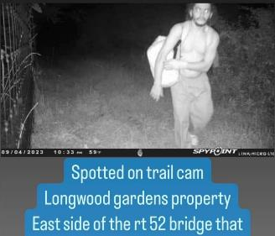
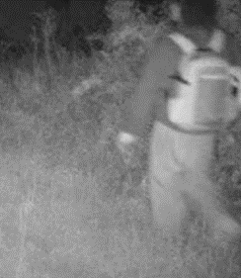
Timeline (Day 7)
Tuesday, 9/6
Escaped prisoner caught on camera twice
On trail along our property line.

Slide 17
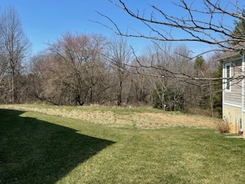
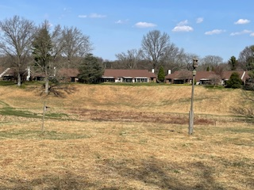
Timeline (Days 7 – 10)
Tuesday, 9/6 through Saturday 9/9
Routine command center operations continue
State Police use our ATV’s and trail maps to search our wooded areas.
US Border Patrol Agents with horses and dogs arrive on site and begin searching
Journalists gather at main entrance
TV van drives onto campus and is escorted off
Sighting Near Cottage
Sighting At Far Side of Field Near Cottage

Slide 18
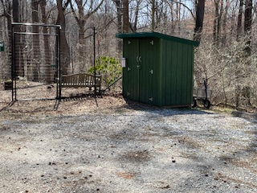
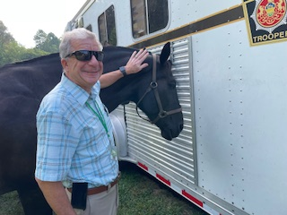
Timeline (Days 7 – 10 Continued)
Trooper Dixon
Sighting Going Into Garden Shed

Slide 19
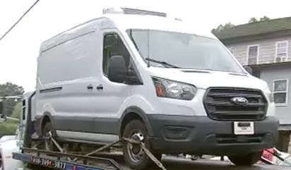
Timeline (Days 11-13)
Sunday, 9/10
12:19 PM – Singlewire: Escaped prisoner reported to be out of our area. Lockdown Ends.
Lisa issues final Safety and Operations Update memo
Day 13 – Escaped prisoner captured
Safety and Operations Update memo issued by Lisa Marsilio, CEO

Slide 20
Michele Berardi
Senior Director of Communications and Public Relations

Slide 21
Internal and External Crisis Comms
  In 9 days – 9 memos to a diverse audience: residents, staff, board members, families of health center residents, families of high school students, media, broader community
  4 press releases ready to go depending on outcome of the situation
  Press statement placed on website
  Monitored countless social media posts on Facebook, Instagram, X and the You Tube online live streamers
Notes:
Those “days” Roy mentioned, we had, in addition to the Single Wire messages, 1 memo per day to a diverse audience

Slide 22
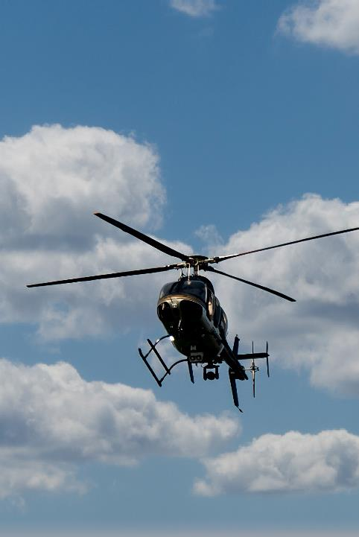
Communications Content
Lockdown updates
Safety measures (i.e. Campus Responders are available for escort to/from your vehicle, stay in groups, staff on patrol, etc.)
Resident access to main centers
Escaped prisoner updates and sightings
Command Center updates, important phone numbers, 911 usage
Transportation availability and schedules
Authority instructions (remain in place, lock cars, no keys in cars, etc.)
Authority activity on campus (dogs, horses, helicopters, home and car searches)
Campus road entrance and exit changes
Memo to the parents (many high school-aged staff in culinary)
Photo courtesy of J. Salvas, Crosslands resident

Slide 23
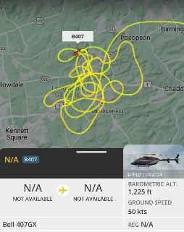
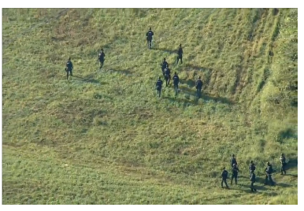



Social Effect
Live Streaming 24/7
Everyday citizens posting helicopter patterns, sightings, activity on social media
Notes:
Not only do you have these “you tubers” on site reporting, you have every day citizens reporting what is happening with videos, etc.

Slide 24

Photo courtesy of J. Salvas, Crosslands resident; time lapse of helicopter patterns and stars

Slide 25
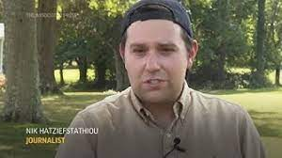
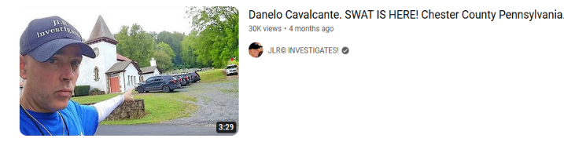
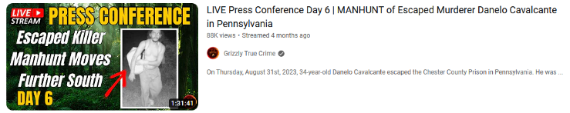
The Media
Quickly realized the media was more than CBS, ABC, NBC, and Fox
Notes:
Netherlands 88,000 views

Slide 26
Seth Beaver
Vice President of Community Services

Slide 27


Debrief
Held debrief with state police and county emergency services
Staff reviewed timeline of events and discussed what went right and wrong
Attended Community Townhall Meetings to stay informed
Support services for residents and staff

Slide 28
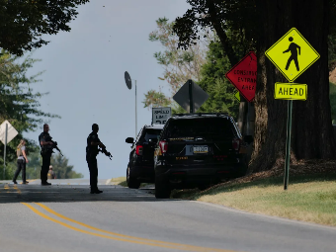
What Worked Well?
Team Meetings
Communications
Singlewire messages (beginning/end of each day)
Memos to residents, staff and board
Command Center to funnel all calls/communications
Relationship to Police
Real-time facts
Tons of incorrect information
Door to door searches of our residences
Multiple meetings per day via zoom
Used COVID playbook

Slide 29
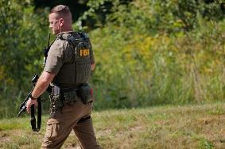
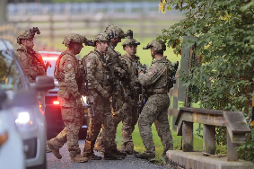
Lessons Learned
Creating Command Center not in Emergency Plan nor the Prison
Didn’t Notify Police of Daycare
Backup Wifi Coverage
Shelter-in-Place v Lockdown
Communicating the severity of the event to the residents
Away forms for Residents
Unlocked cars on campus
Staff involvement

Slide 30






Authority Icons
agents from Buffalo, Detroit, Blaine, Washington, and Swanton, Vermont, as well as the Border Patrol's Special Operations Group in El Paso, Texas,
There was an Air and Marine Operations (AMO) ground tactical air controller (GTAC) who helped the State Police in their search

Slide 31
Authorities
Lieutenant Daniel D. Steele, Station Commander, Troop J, Avondale – Operations Section Commander AM Shift (manhunt)
Captain Robert C. Wagner, Troop Commander, Troop J, Lancaster - Deputy Incident Commander AM Shift (manhunt)
Lieutenant Christopher J. Winesburg, Station Commander, Troop J, Lancaster – Deputy Incident Commander PM Shift (manhunt)
Lieutenant Michael A. Stoner, Station Commander, Troop J, Embreeville – Operations Section Commander PM Shift (manhunt)
Lieutenant Jennifer A. Ward-Trupp, Patrol Section Commander, Troop J, Lancaster – Planning Section Commander (manhunt)
Lieutenant William Donahue, Criminal Investigation Commander, Troop J Lancaster (manhunt)

Slide 32
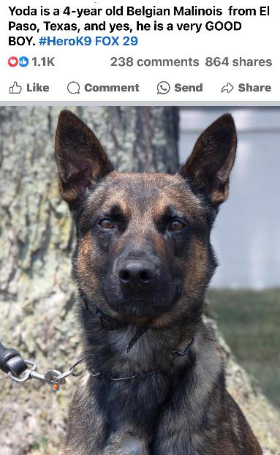
Yoda
Hero K9

Slide 33
How The Residents Felt
“Because administration kept us safe during COVID, we trusted them to keep us safe now”
“The communication was ongoing and appreciative knowing we received accurate information”
“We all felt very safe”
“We were accustomed to lock downs (from COVID), but the armed officials, almost military-like was unnerving”

Slide 34
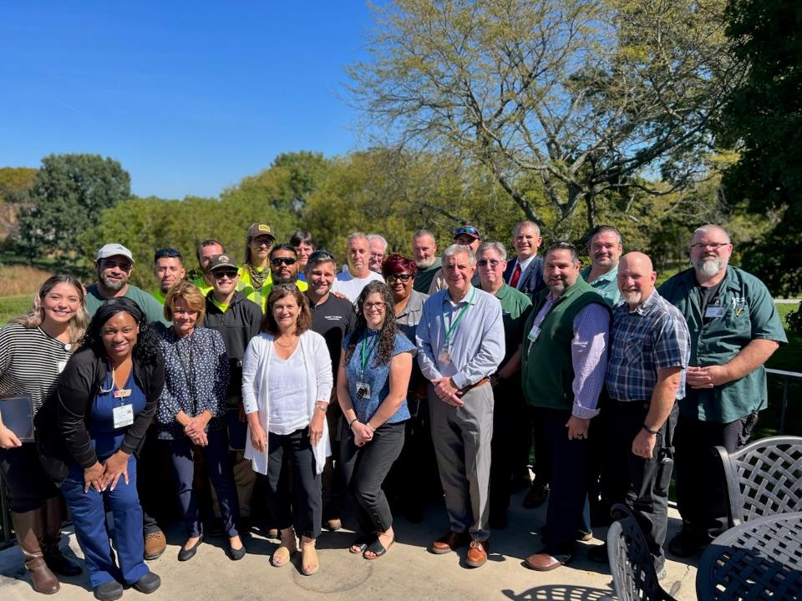
Questions

